Slide 1
Seizure Prediction
Matthew Brawley
Rashmi Agrawal
Shruti Kannan

Slide 2
Project Goal
Develop a system to predict epileptic seizures using EEG recordings; treating the recordings as real time EEG data of an epileptic patient.
Develop an app to provide notification to the patient and an emergency contact during the seizure stages

Slide 3
Main use cases
Epileptic Patient
  To reduce persistent anxiety
  To help them avoid doing potentially dangerous activities
  To seek timely medical assistance
  To ensure more effective use of medication
Emergency Contact
  To make an emergency contact aware about the patient’s oncoming seizure
Doctor
  To provide the patient with timely medical assistance, if needed

Slide 4
Project Background

Slide 5
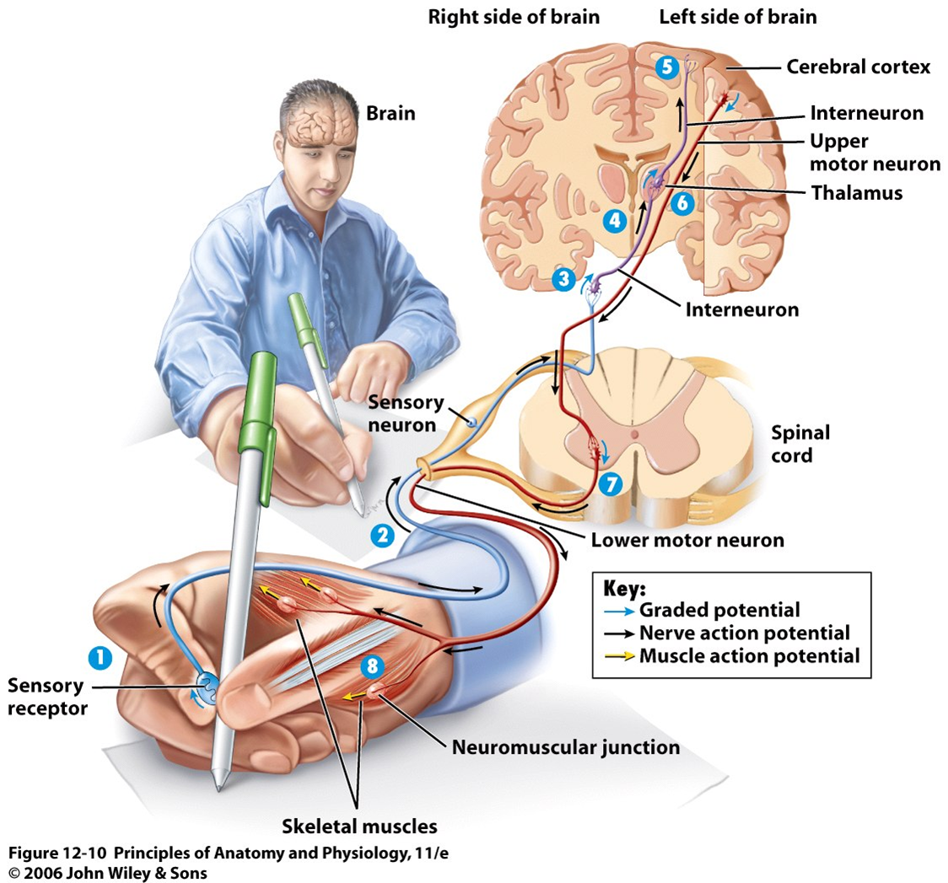
Introduction to Nervous System
https://classconnection.s3.amazonaws.com/704/flashcards/586704/png/process_of_sensory_to_motor_information1309991095188.png

Slide 6
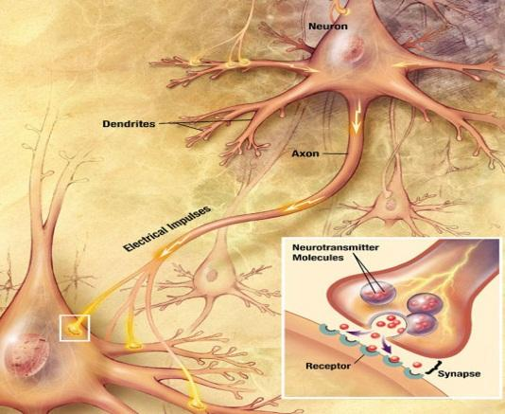
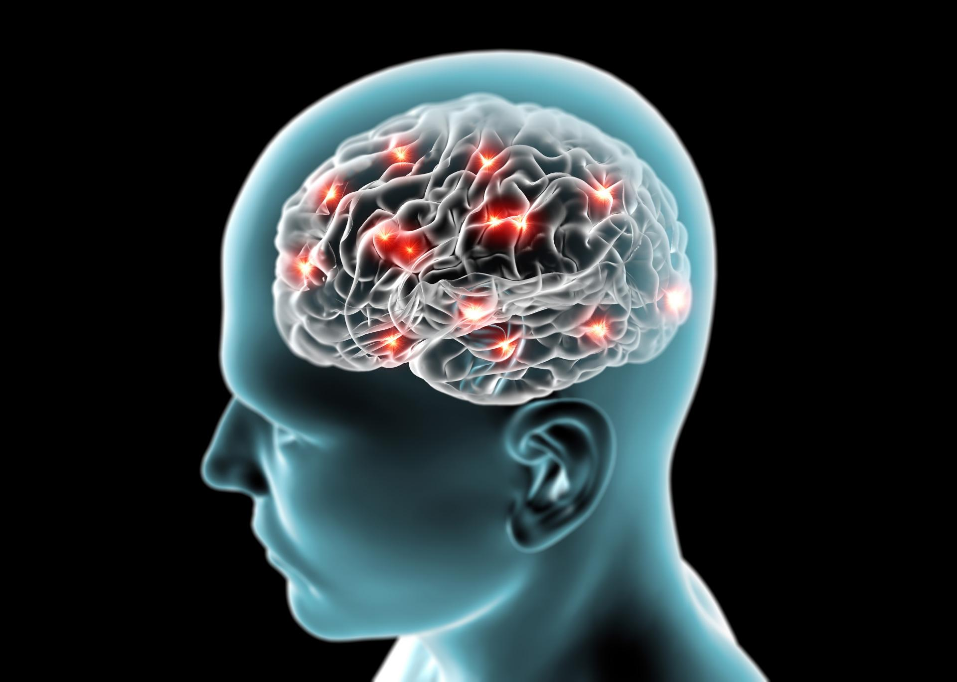
Electrical Activity in Brain
http://www.ducksters.com/science/nervous_system_nerve.jpg
http://medvoice.ru/wp-content/uploads/2016/01/bolezn-alcgeymera1.jpg

Slide 7
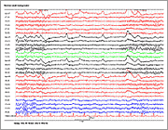
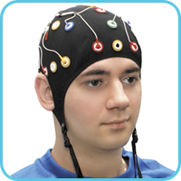
EEG
http://www.epilepsy.com/learn/epilepsy-101/what-seizure
http://www.medicom-mtd.com/htm/Products/gallery/images/video_02.jpg

Slide 8
Seizures
Electrical activity in the brain- Caused by complex chemical changes that occur in nerve cells.
Sometimes, these chemical changes can lead to surges of electrical activity that cause seizures.
Seizures are not a disease in themselves. Instead, they are a symptom of many different disorders that can affect the brain.

Slide 9
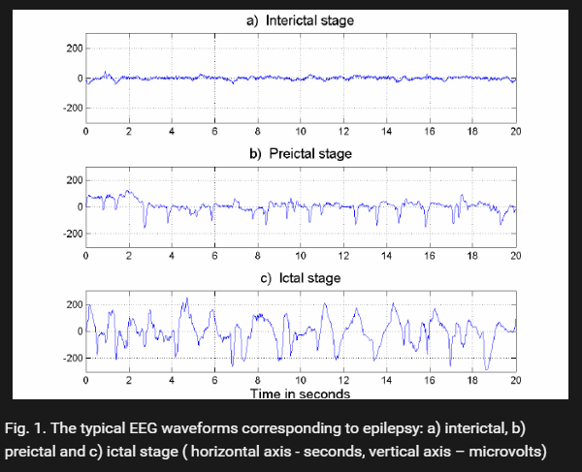
Stages of Seizure
https://www.researchgate.net/figure/225696687_fig1_Fig-1-The-typical-EEG-waveforms-corresponding-to-epilepsy-a-interictal-b-preictal [accessed Oct 3, 2016]

Slide 10
Product Basis

Slide 11
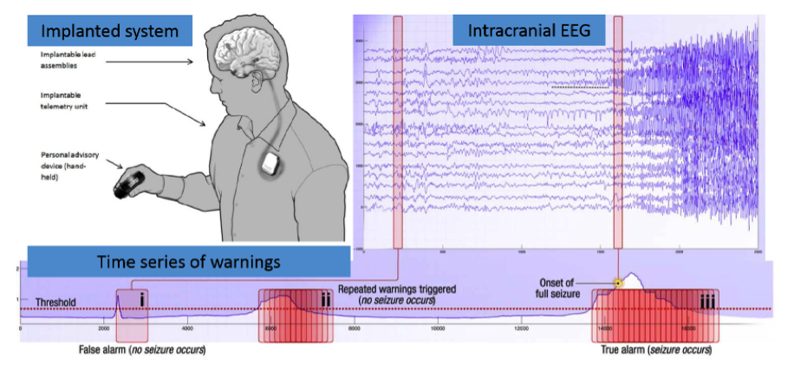
https://www.kaggle.com/c/melbourne-university-seizure-prediction

Slide 12
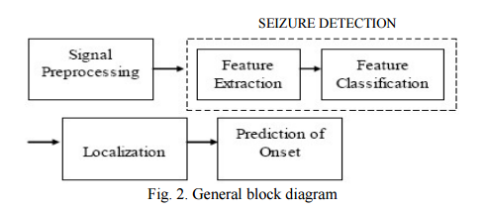
System Level Diagram Level-1
Processing Unit
[1]
EEG Data
Database
App
Emergency Contact
[1]
Patient
Kavya Devarajan, E. Jyostna, K. Jayasri, and Vinitha Balasampath EEG-Based Epilepsy Detection and Prediction, IACSIT International Journal of Engineering and Technology, Vol. 6, No. 3, June 2014

Slide 13
Challenges & Limitations
No real time data. Need to process the pre-recorded EEG data.
Data set is huge, about 60 GB, and processing power can be a challenge.
Mat file processing
No linear threshold to predict the onset of seizures. So, machine learning tools are required.
EEG has many artefacts which makes it even more difficult to filter the data.
Kaggle Competition - https://www.kaggle.com/c/melbourne-university-seizure-prediction

Slide 14
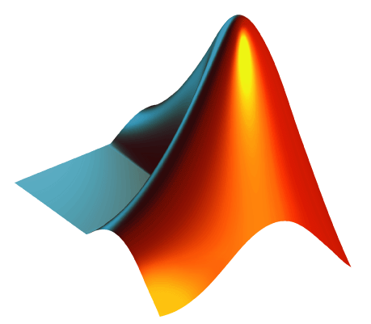




Tools
Data Processing
  MATLAB & Python
  Sci-Kit
Database
  MySQL
Front End
  Android

Slide 15
Next Sprint
Main task will be to analyze the data set
Determine advantageous machine learning algorithms
Develop initial database, design database for the analyzed data as an input

Slide 16
THANK YOU!
QUESTIONS?

